Slide 1
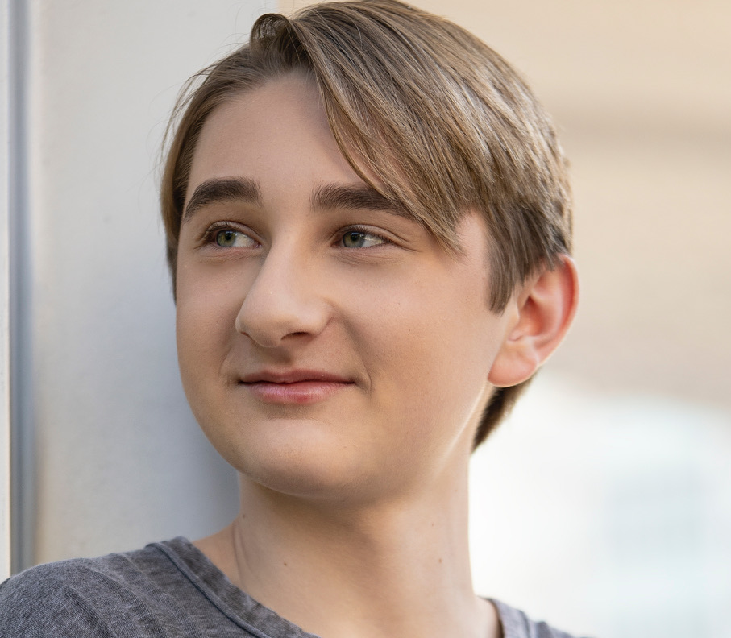





Cole Trafton Bishop
coletraftonbishop@gmail.com
704-343-1159
MY MESSAGE TO you
CERTIFICATION
As an inspiring, diligent young man who strives to do my best I believe I would be a great asset to your company. My goal is to give back to individuals and my community. I believe I can do this through your business which will allow me to further develop my interpersonal and leadership skills, and build upon my life’s purpose.
Lifeguard with CPR/AED for the Professional Rescuer and First Aid
#01PADLP (expires 2/25/26)
ATHLETICS
EDUCATION
Varsity Swim Team
Carroll Senior High School
Texas Tech University – Strategic Communications
Junior Varsity Swim Team
Carroll Senior High School
Aug 2024 - Present
Lubbock, TX
SPECIAL SKILLS
WORK EXPERIENCE
Lifeguard & Swim Instructor – The City of Grapevine
Ethical Grounding
Listening Skills
Communication Skills
Problem Solving Skills
Critical Thinking
Crowd Control
Leadership Abilities
Advanced Swimming Skills (+16 years)
American Sign Language (3 years)
Instruct students on various swimming strokes, techniques, and water safety. Create and implement lesson plans tailored to different skill levels and age groups. Evaluate student progress and adjust instruction accordingly.
April 2024 – August 2024
Actor – G & G Talent
Professional representation and coaching in preparation for television and film production. Coordination with Manager for scene taping, script memorization and professional submissions to production studios.
Dec 2019 – Oct 2022
Scott David Professional Coaching
AWARDS
Thorough actor training for character and script analysis by the former casting director best known for his participation in the actor selection for television series Criminal Minds.
Top 10 Performer
Premier Global Actor Search
December 2019
Dec 2019 – Aug 2021

